Slide 1

hyperchain
Lighting Fast Trades

Slide 2
Problem Statement
Trading of security requires a lot of human involvement especially for settlements.
Moreover the errors made during trade cycle is to be incurred by institutes providing trading facility , also takes days to perform settlement which requires cash and time.
<number>

Slide 3

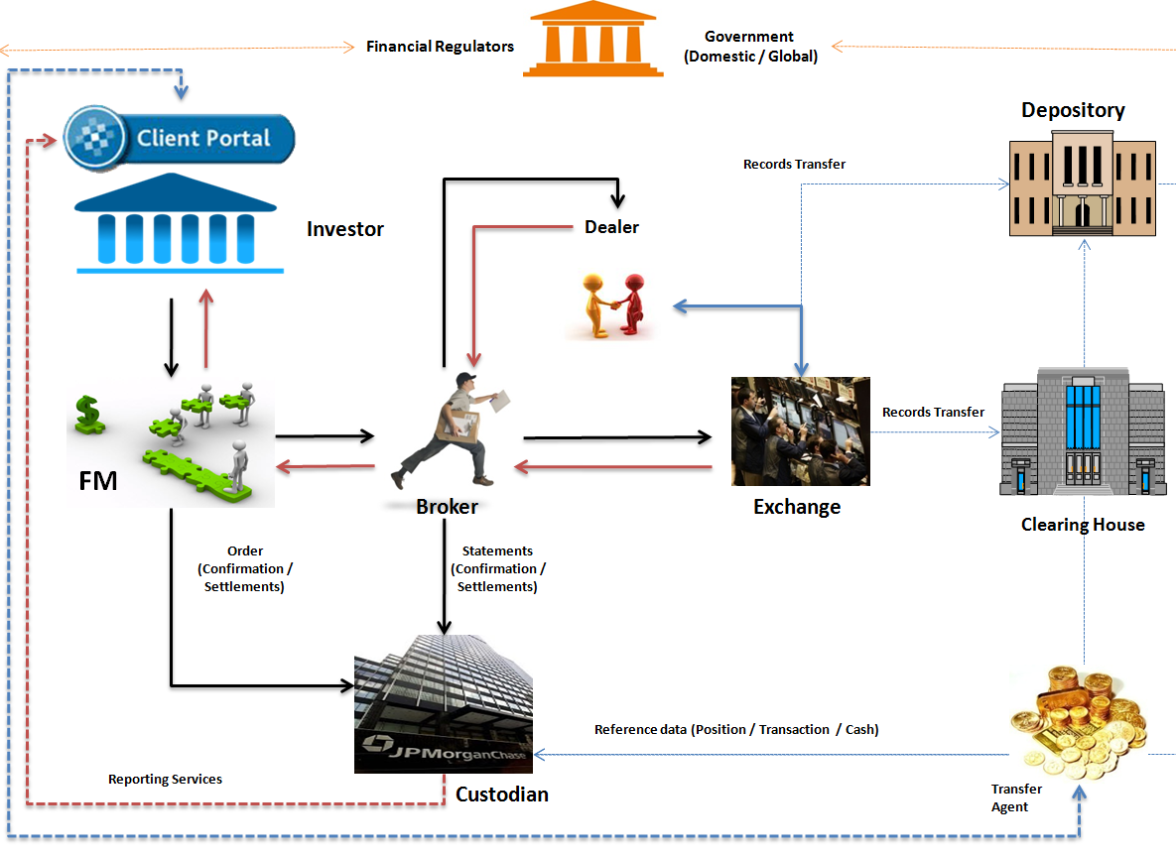
Trade Lifecycle
<number>

Slide 4
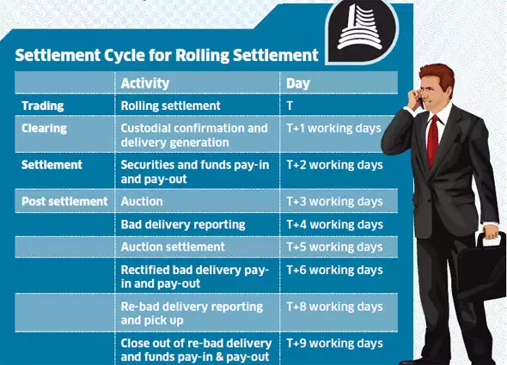
Drawbacks in Status Quo
<number>

Slide 5
Proposed Solution
To represent intangible assets like equities/stock, etc
into digitial assets which leads to minimal trade processing by deploying these assets on distributed ledger among participants in trade life cycle.
Participants can be traders, issuers & regulatory department
<number>

Slide 6
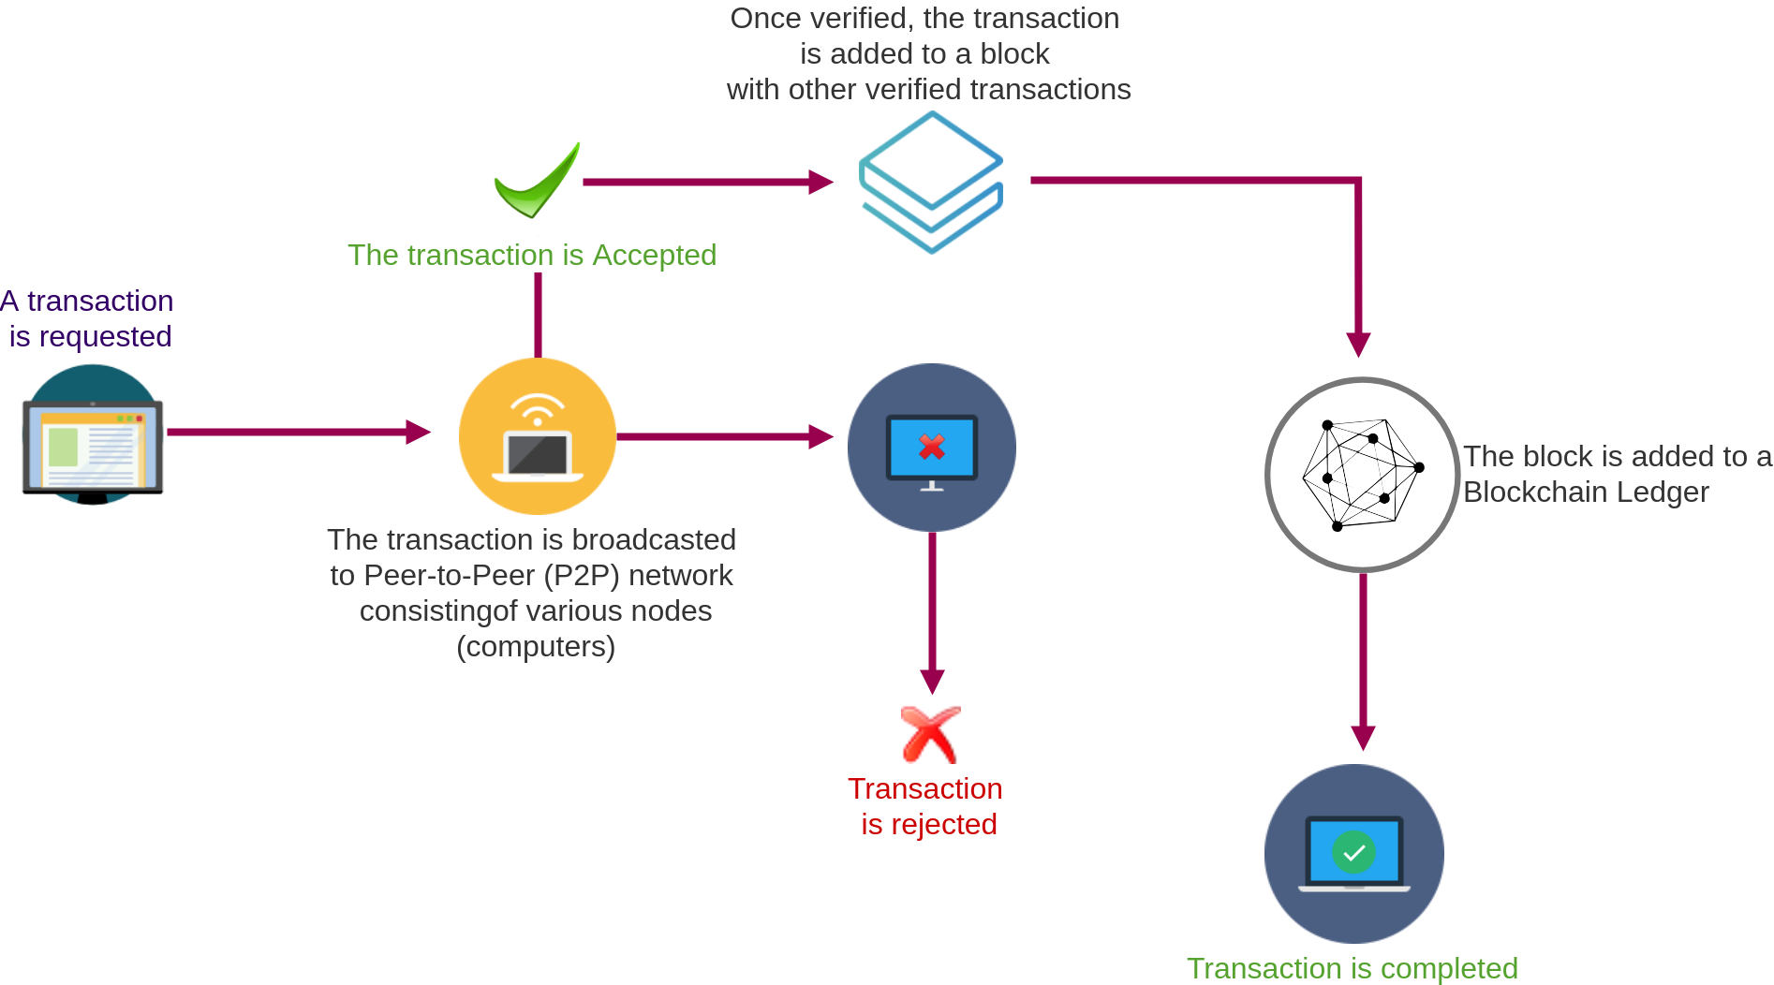
How it works?
<number>

Slide 7





Technologies
hyperchain

Slide 8
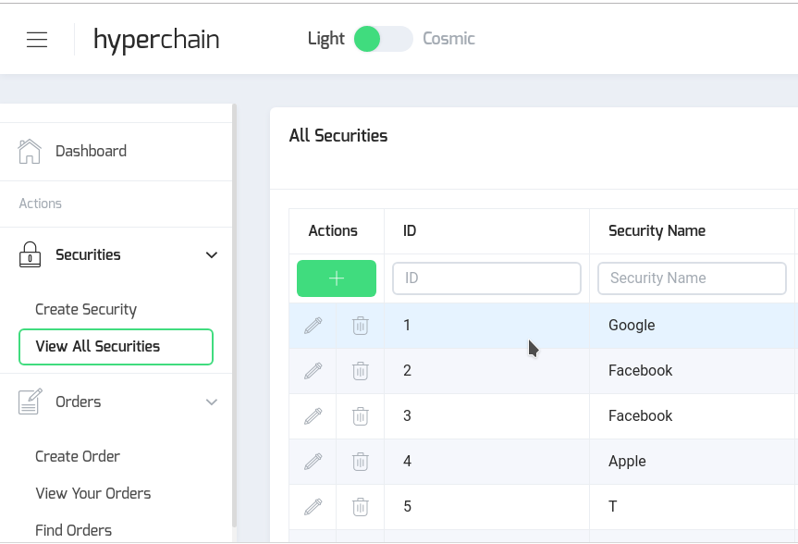
App Demo
<number>

Slide 9
THANK YOU
Q&A

